Slide 1
Announcements
Midterm 1
Graded midterms available on pandagrader
See Piazza for post on how fire alarm is handled
Project 4: Ghostbusters
Due Friday at 5pm
Homework 7
Due Tuesday 4/1 at 11:59pm
Project 3 Contest Results
On Thursday

Slide 2
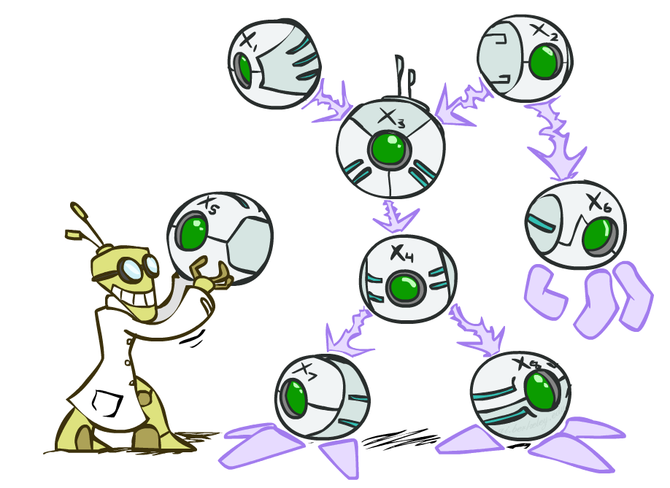
CS 188: Artificial Intelligence
Bayes’ Nets
Instructors: Dan Klein and Pieter Abbeel --- University of California, Berkeley
[These slides were created by Dan Klein and Pieter Abbeel for CS188 Intro to AI at UC Berkeley. All CS188 materials are available at http://ai.berkeley.edu.]
Notes:
Please retain proper attribution, including the reference to ai.berkeley.edu. Thanks!

Slide 3

Probabilistic Models
Models describe how (a portion of) the world works
Models are always simplifications
May not account for every variable
May not account for all interactions between variables
“All models are wrong; but some are useful.” – George E. P. Box
What do we do with probabilistic models?
We (or our agents) need to reason about unknown variables, given evidence
Example: explanation (diagnostic reasoning)
Example: prediction (causal reasoning)
Example: value of information
Notes:
George Box: All models are wrong; some of them are useful

Slide 4
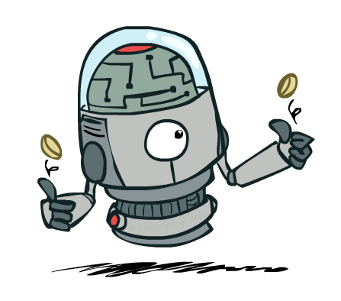
Independence

Slide 5
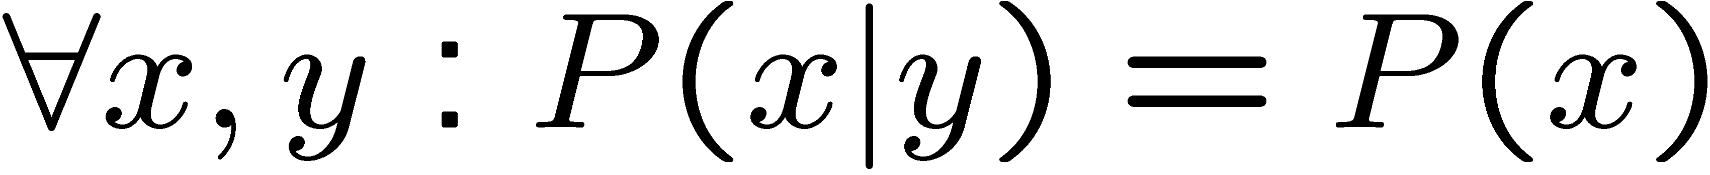
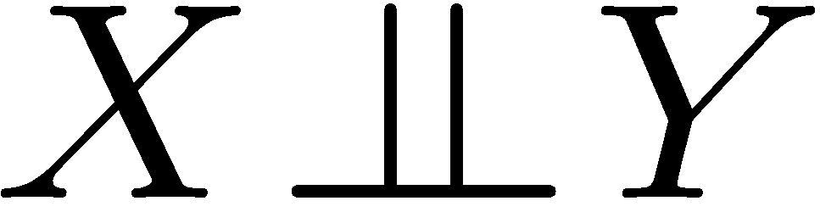
Independence
Two variables are independent if:
This says that their joint distribution factors into a product two simpler distributions
Another form:
We write:
Independence is a simplifying modeling assumption
Empirical joint distributions: at best “close” to independent
What could we assume for {Weather, Traffic, Cavity, Toothache}?

Slide 6
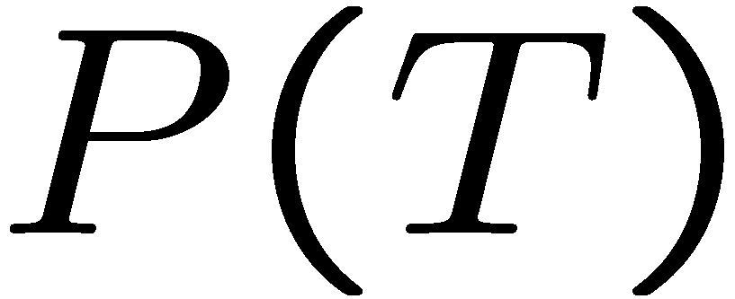
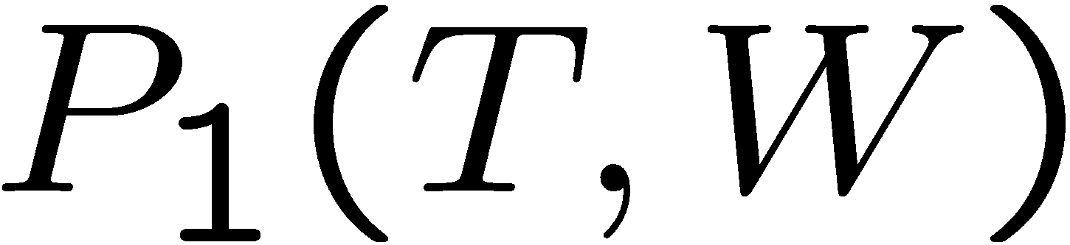
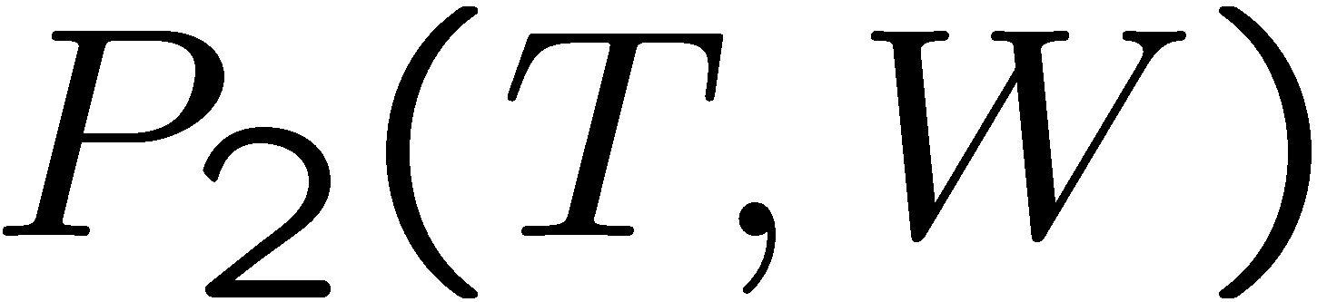
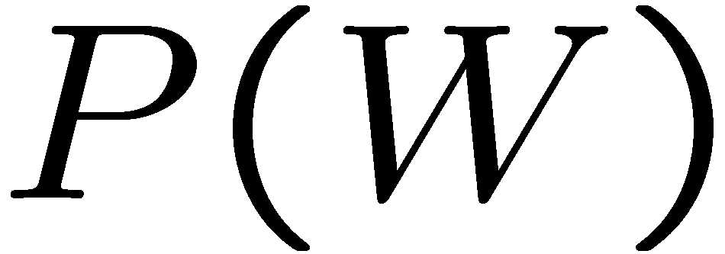
Example: Independence?
T | P
hot | 0.5
cold | 0.5
T | W | P
hot | sun | 0.4
hot | rain | 0.1
cold | sun | 0.2
cold | rain | 0.3
T | W | P
hot | sun | 0.3
hot | rain | 0.2
cold | sun | 0.3
cold | rain | 0.2
W | P
sun | 0.6
rain | 0.4

Slide 7


Example: Independence
N fair, independent coin flips:
H | 0.5
T | 0.5
H | 0.5
T | 0.5
H | 0.5
T | 0.5

Slide 8
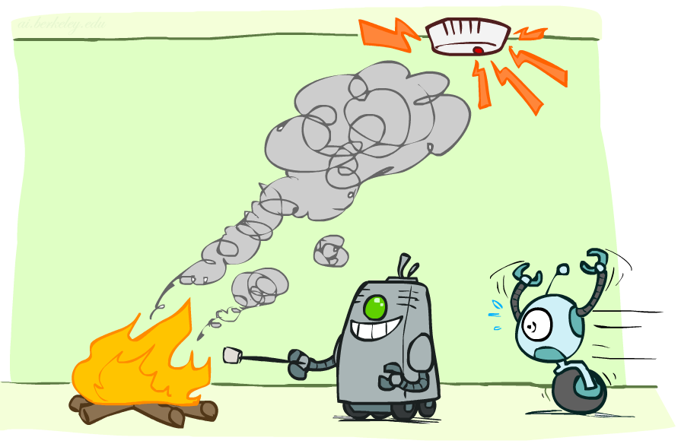
Conditional Independence

Slide 9
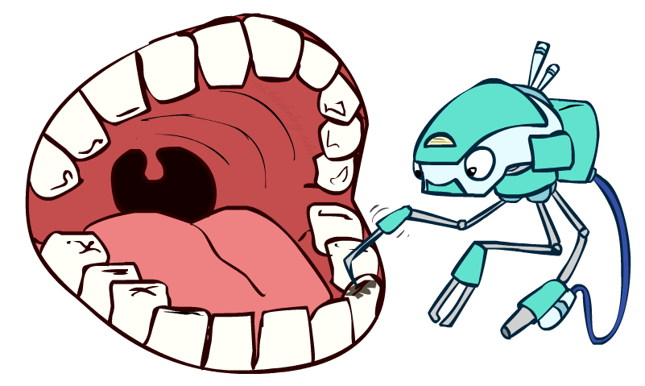
Conditional Independence
P(Toothache, Cavity, Catch)
If I have a cavity, the probability that the probe catches in it doesn't depend on whether I have a toothache:
P(+catch | +toothache, +cavity) = P(+catch | +cavity)
The same independence holds if I don’t have a cavity:
P(+catch | +toothache, -cavity) = P(+catch| -cavity)
Catch is conditionally independent of Toothache given Cavity:
P(Catch | Toothache, Cavity) = P(Catch | Cavity)
Equivalent statements:
P(Toothache | Catch , Cavity) = P(Toothache | Cavity)
P(Toothache, Catch | Cavity) = P(Toothache | Cavity) P(Catch | Cavity)
One can be derived from the other easily

Slide 10
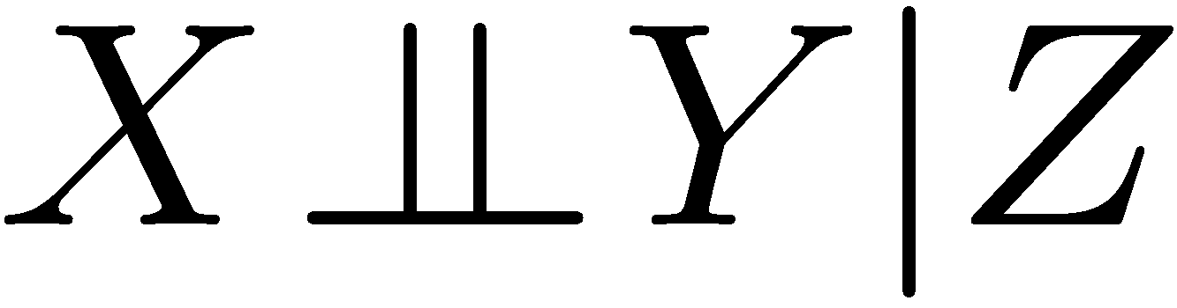
Conditional Independence
Unconditional (absolute) independence very rare (why?)
Conditional independence is our most basic and robust form of knowledge about uncertain environments.
X is conditionally independent of Y given Z
if and only if:
or, equivalently, if and only if

Slide 11
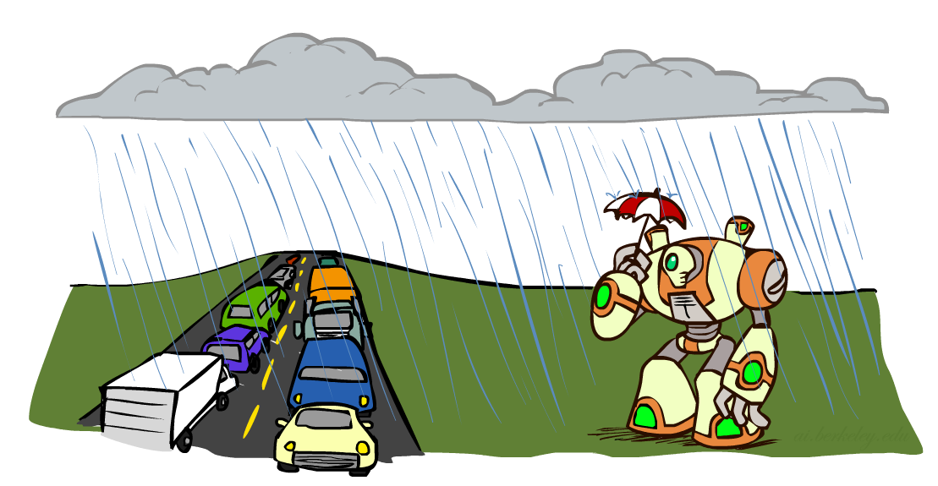
Conditional Independence
What about this domain:
Traffic
Umbrella
Raining

Slide 12

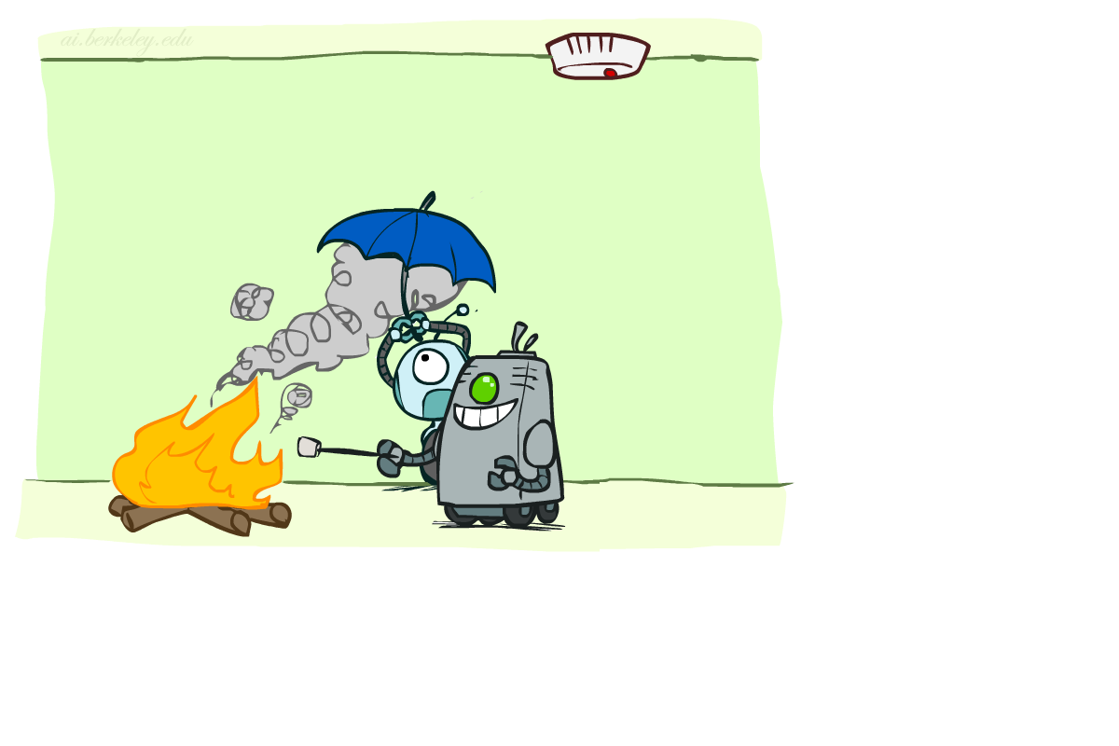
Conditional Independence
What about this domain:
Fire
Smoke
Alarm

Slide 13

Conditional Independence and the Chain Rule
Chain rule:
Trivial decomposition:
With assumption of conditional independence:
Bayes’nets / graphical models help us express conditional independence assumptions

Slide 14
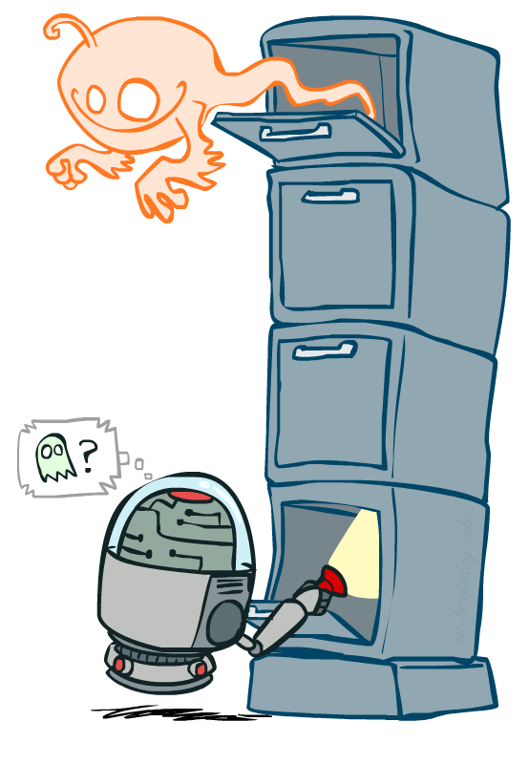
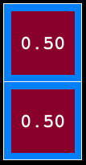
Ghostbusters Chain Rule
Each sensor depends only on where the ghost is
That means, the two sensors are conditionally independent, given the ghost position
T: Top square is red B: Bottom square is red G: Ghost is in the top
Givens:
P( +g ) = 0.5
P( -g ) = 0.5
P( +t | +g ) = 0.8 P( +t | -g ) = 0.4 P( +b | +g ) = 0.4 P( +b | -g ) = 0.8
P(T,B,G) = P(G) P(T|G) P(B|G)
T | B | G | P(T,B,G)
+t | +b | +g | 0.16
+t | +b | -g | 0.16
+t | -b | +g | 0.24
+t | -b | -g | 0.04
-t | +b | +g | 0.04
-t | +b | -g | 0.24
-t | -b | +g | 0.06
-t | -b | -g | 0.06

Slide 15
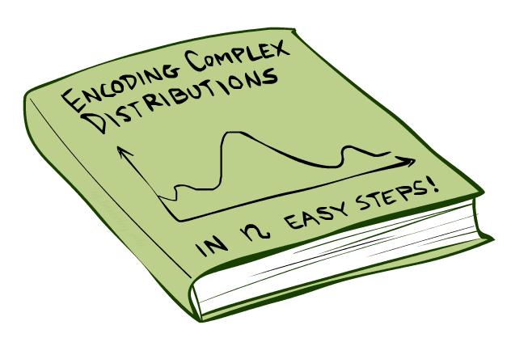
Bayes’Nets: Big Picture

Slide 16

Bayes’ Nets: Big Picture
Two problems with using full joint distribution tables as our probabilistic models:
Unless there are only a few variables, the joint is WAY too big to represent explicitly
Hard to learn (estimate) anything empirically about more than a few variables at a time
Bayes’ nets: a technique for describing complex joint distributions (models) using simple, local distributions (conditional probabilities)
More properly called graphical models
We describe how variables locally interact
Local interactions chain together to give global, indirect interactions
For about 10 min, we’ll be vague about how these interactions are specified

Slide 17
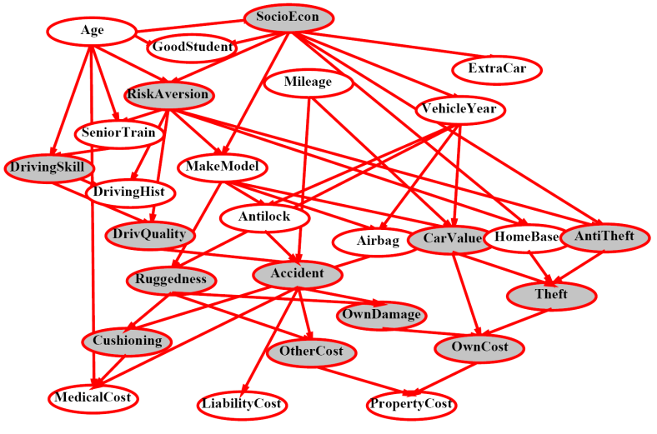
Example Bayes’ Net: Insurance

Slide 18
Example Bayes’ Net: Car

Slide 19
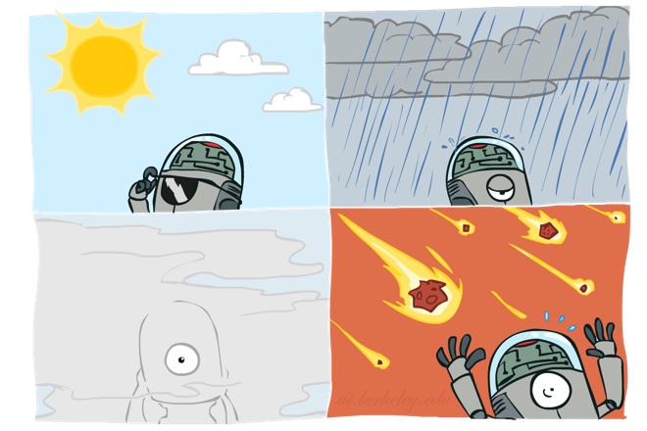
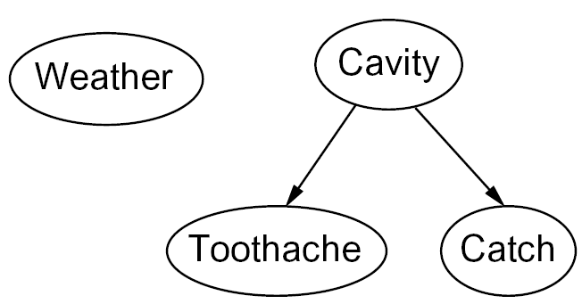
Graphical Model Notation
Nodes: variables (with domains)
Can be assigned (observed) or unassigned (unobserved)
Arcs: interactions
Similar to CSP constraints
Indicate “direct influence” between variables
Formally: encode conditional independence (more later)
For now: imagine that arrows mean direct causation (in general, they don’t!)

Slide 20
Example: Coin Flips
N independent coin flips
No interactions between variables: absolute independence
X₁
X₂
X_{n}

Slide 21
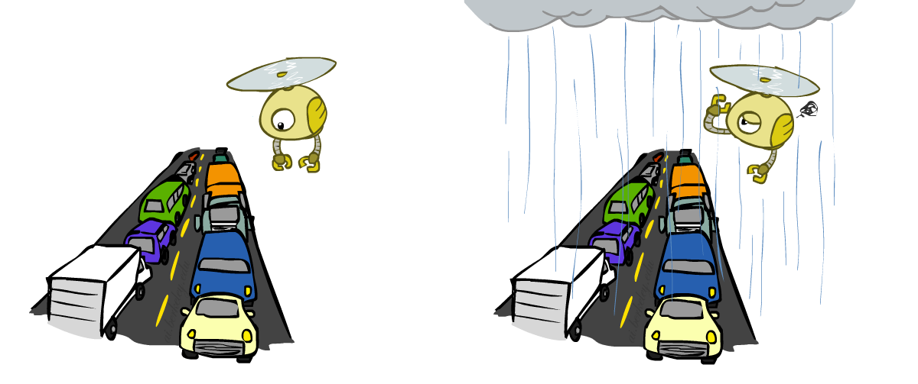
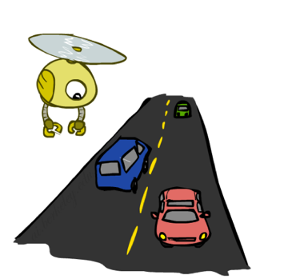
Example: Traffic
Variables:
R: It rains
T: There is traffic
Model 1: independence
Why is an agent using model 2 better?
Model 2: rain causes traffic
R
R
T
T

Slide 22
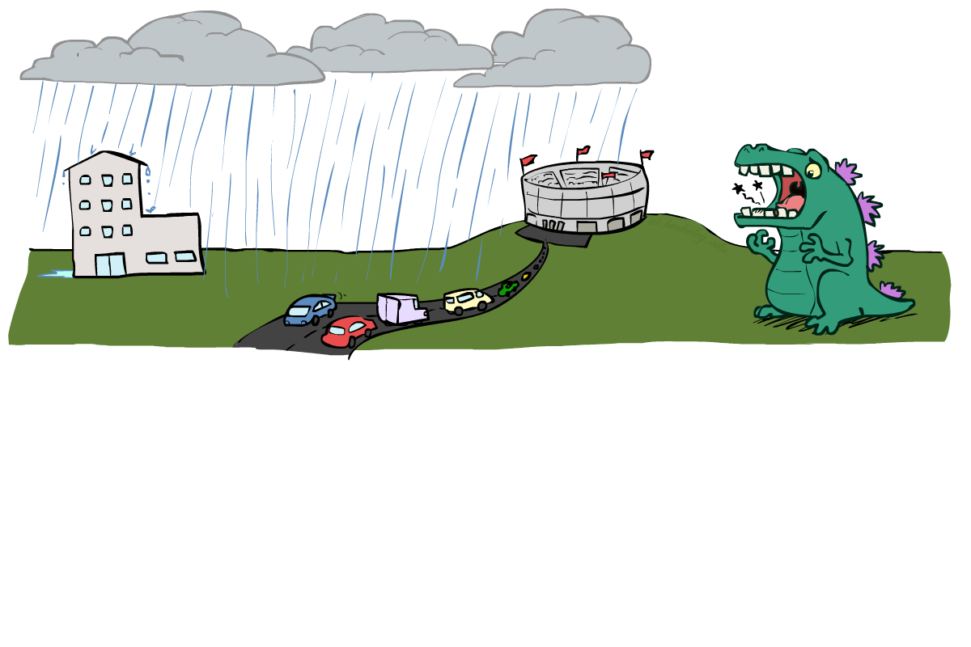
Example: Traffic II
Let’s build a causal graphical model!
Variables
T: Traffic
R: It rains
L: Low pressure
D: Roof drips
B: Ballgame
C: Cavity

Slide 23
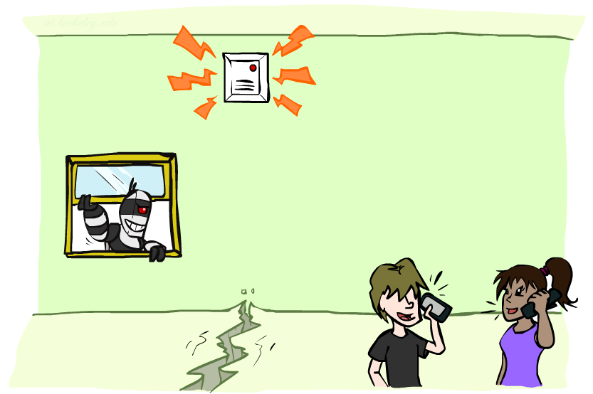
Example: Alarm Network
Variables
B: Burglary
A: Alarm goes off
M: Mary calls
J: John calls
E: Earthquake!

Slide 24
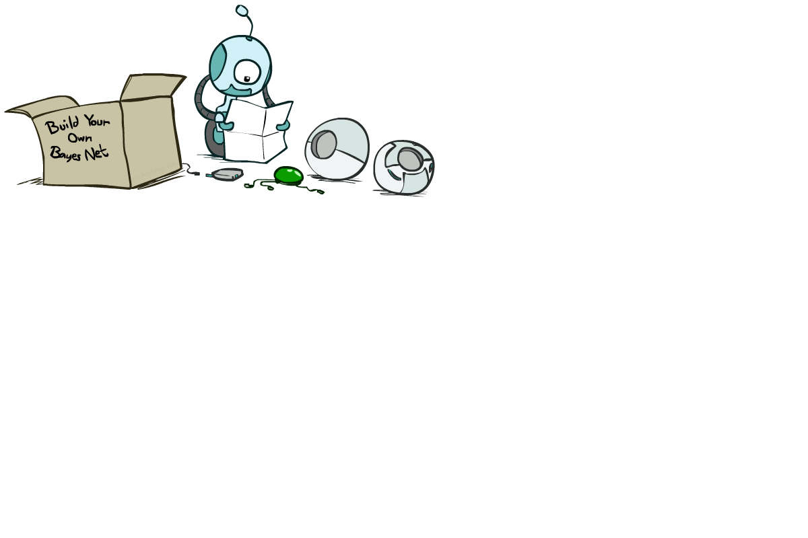
Bayes’ Net Semantics

Slide 25
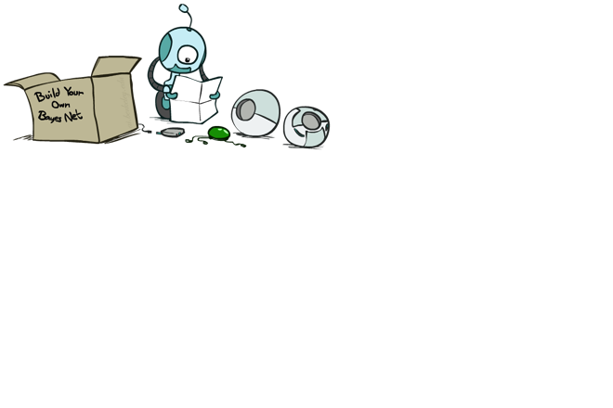
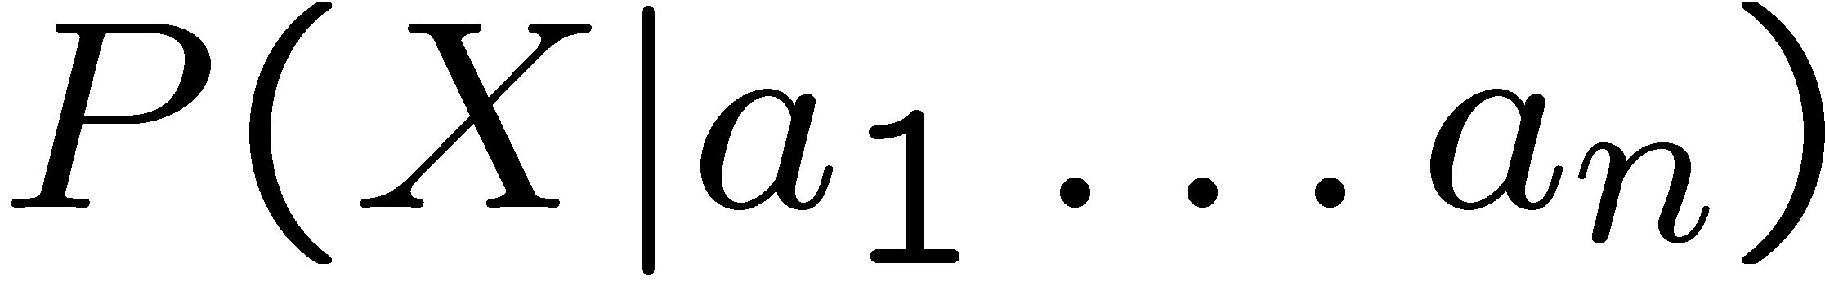
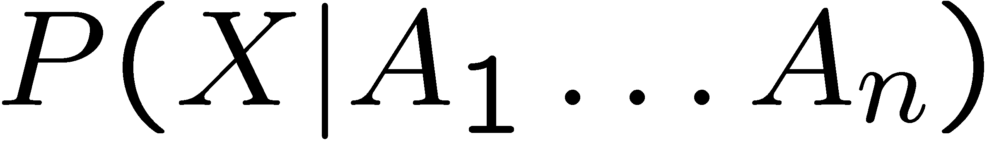
Bayes’ Net Semantics
A set of nodes, one per variable X
A directed, acyclic graph
A conditional distribution for each node
A collection of distributions over X, one for each combination of parents’ values
CPT: conditional probability table
Description of a noisy “causal” process
A₁
A_{n}
X
A Bayes net = Topology (graph) + Local Conditional Probabilities

Slide 26
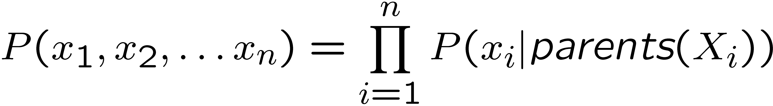
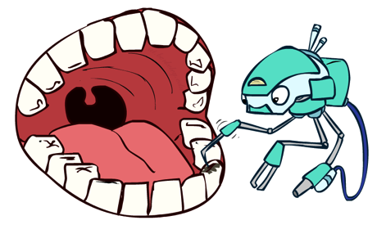
Probabilities in BNs
Bayes’ nets implicitly encode joint distributions
As a product of local conditional distributions
To see what probability a BN gives to a full assignment, multiply all the relevant conditionals together:
Example:

Slide 27
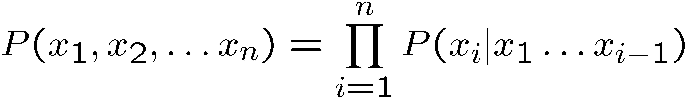
Probabilities in BNs
Why are we guaranteed that setting
results in a proper joint distribution?
Chain rule (valid for all distributions):
Assume conditional independences:
→ Consequence:
Not every BN can represent every joint distribution
The topology enforces certain conditional independencies

Slide 28
Example: Coin Flips
X₁
X₂
X_{n}
h | 0.5
t | 0.5
h | 0.5
t | 0.5
h | 0.5
t | 0.5
Only distributions whose variables are absolutely independent can be represented by a Bayes’ net with no arcs.
Notes:
demo

Slide 29



Example: Traffic
R
+r | 1/4
-r | 3/4
+r | +t | 3/4
 | -t | 1/4
T
-r | +t | 1/2
 | -t | 1/2
Notes:
demo

Slide 30

Example: Alarm Network
B | P(B)
+b | 0.001
-b | 0.999
E | P(E)
+e | 0.002
-e | 0.998
Burglary
Earthqk
Alarm
B | E | A | P(A|B,E)
+b | +e | +a | 0.95
+b | +e | -a | 0.05
+b | -e | +a | 0.94
+b | -e | -a | 0.06
-b | +e | +a | 0.29
-b | +e | -a | 0.71
-b | -e | +a | 0.001
-b | -e | -a | 0.999
John calls
Mary calls
A | J | P(J|A)
+a | +j | 0.9
+a | -j | 0.1
-a | +j | 0.05
-a | -j | 0.95
A | M | P(M|A)
+a | +m | 0.7
+a | -m | 0.3
-a | +m | 0.01
-a | -m | 0.99
Notes:
demo

Slide 31

Example: Traffic
Causal direction
R
+r | 1/4
-r | 3/4
+r | +t | 3/16
+r | -t | 1/16
-r | +t | 6/16
-r | -t | 6/16
+r | +t | 3/4
 | -t | 1/4
T
-r | +t | 1/2
 | -t | 1/2

Slide 32
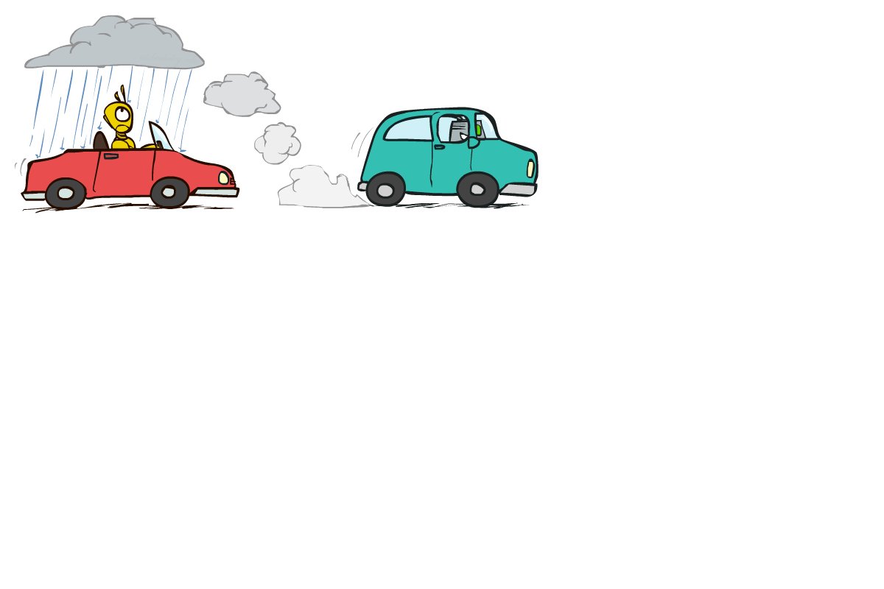

Example: Reverse Traffic
Reverse causality?
T
+t | 9/16
-t | 7/16
+r | +t | 3/16
+r | -t | 1/16
-r | +t | 6/16
-r | -t | 6/16
+t | +r | 1/3
 | -r | 2/3
R
-t | +r | 1/7
 | -r | 6/7

Slide 33
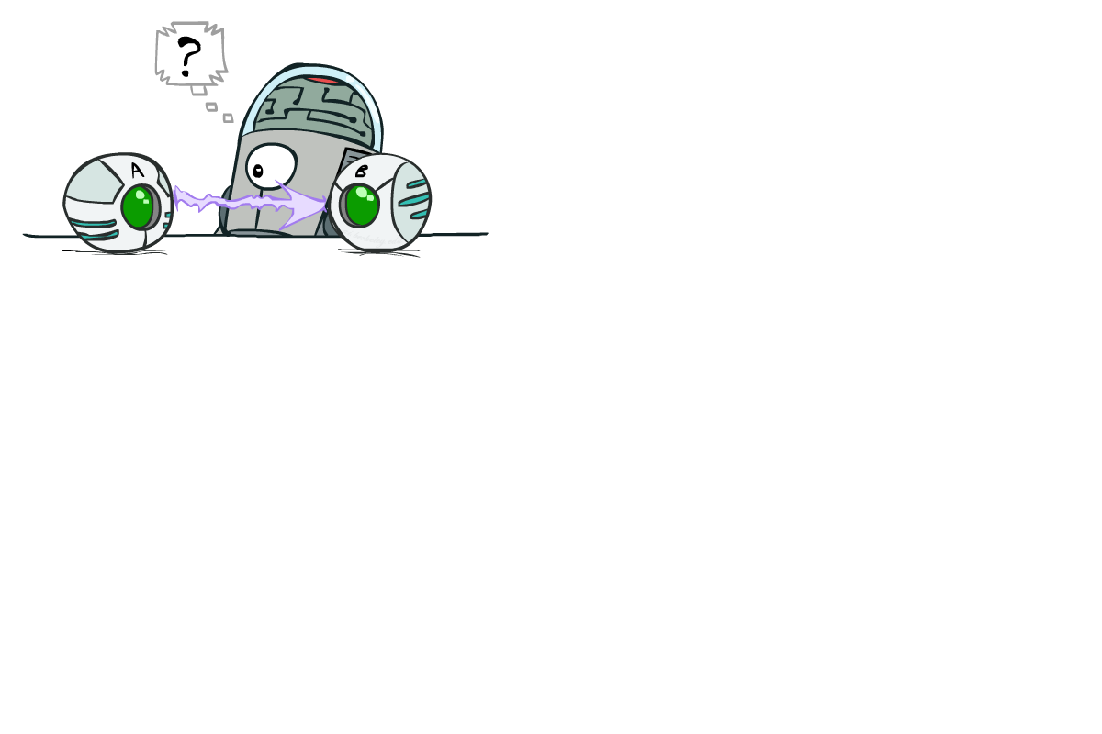
Causality?
When Bayes’ nets reflect the true causal patterns:
Often simpler (nodes have fewer parents)
Often easier to think about
Often easier to elicit from experts
BNs need not actually be causal
Sometimes no causal net exists over the domain (especially if variables are missing)
E.g. consider the variables Traffic and Drips
End up with arrows that reflect correlation, not causation
What do the arrows really mean?
Topology may happen to encode causal structure
Topology really encodes conditional independence

Slide 34
Bayes’ Nets
So far: how a Bayes’ net encodes a joint distribution
Next: how to answer queries about that distribution
Today:
First assembled BNs using an intuitive notion of conditional independence as causality
Then saw that key property is conditional independence
Main goal: answer queries about conditional independence and influence
After that: how to answer numerical queries (inference)

